Slide 1



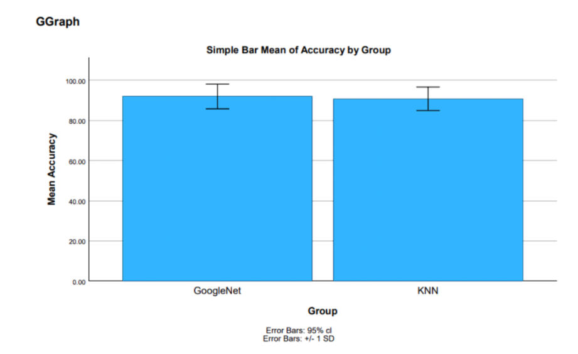
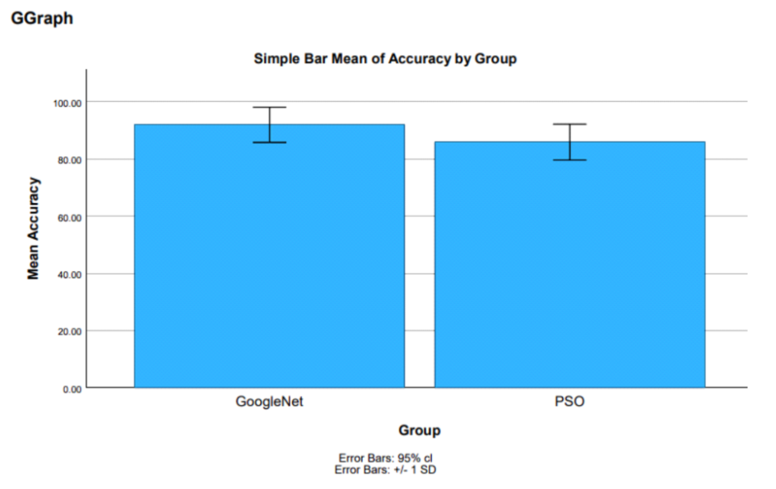
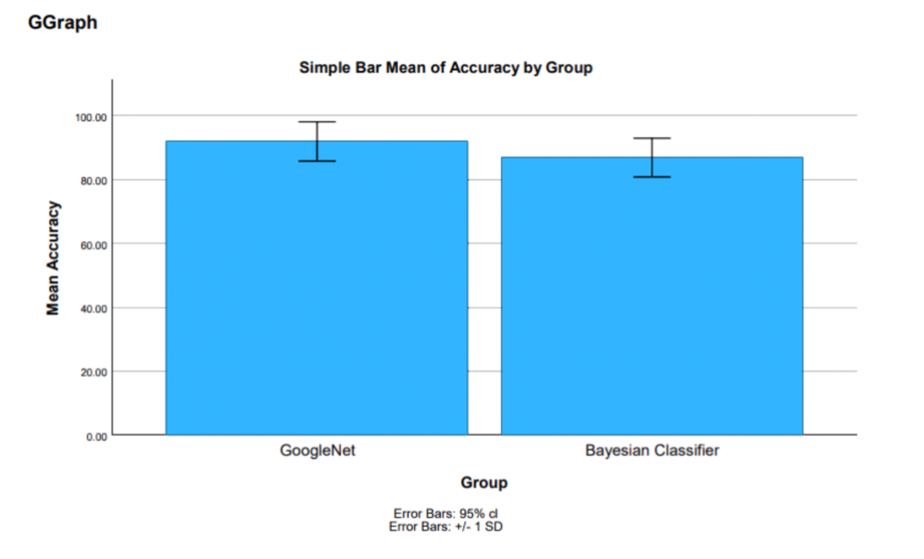
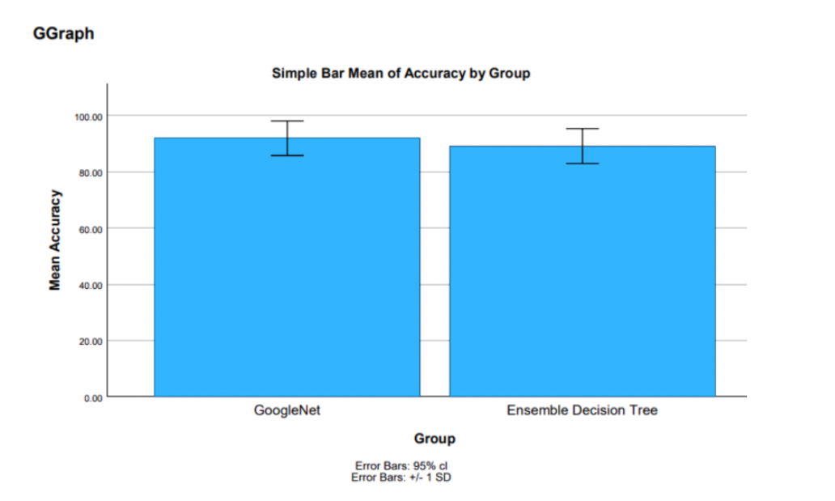
Name: Mr. Bhuvanesh Pamidakula Register Number: 192011001
Guided by Dr. P. Shyamala Bharathi
Ms. Poorani.S
Guided by Dr. Mary Valantina. G
Identification and removal of Hate Speech from Social Media using Google Net Classifier Compared with Machine learning Algorithms
Hate speech refers to content that promotes violence against or has the primary purpose of inciting hatred against individuals or groups based on certain attributes, such as: race or ethnic origin, religion, disability, gender, age, veteran status, sexual orientation/gender identity".
The aim of this study is to separate Innovative Machine Learning (ML) Classifiers to eradicate Hate Speech from social media.
In this research study , Google Net Classifier algorithm is compared with four different algorithms such as K Nearest Neighbor , Particle Swarm Optimizer, Bayesian Regression , Ensemble Decision Tree to enhance accuracy.
The advantage of GoogleNet Classifier has proven to be faster when compared with other image-classification models.
INTRODUCTION
Hate Speech Regulation on Social Media
MATERIALS AND METHODS
Dimension Reduction
Data Collection/
Pre -Processing
Feature Extraction
High Dimension
Classifier Section
Evaluation Hate Speech
No Hate Speech
Hate Speech Detection from Social Media
RESULTS
GNC and KNN
GNC and PSO
GNC and BR
GNC and EDT
In the present work, Google Net Classifier (GNC) is compared with K Nearest Neighbor (KNN), Particle Swarm Optimizer(PSO), Bayesian Regression(BR), Ensemble Decision Tree(EDT)and it depicts that the proposed algorithm gives more accuracy when compared with the rest.
DISCUSSION AND CONCLUSION
Based on T-test Statistical analysis, the significance value of p=0.001 (independent sample T - test p<0.05) is obtained and shows that there is a statistical significant difference between the group 1 and group 2.
Overall , the accuracy of the Google Net Classifier is 91.95 % and it is better than the other algorithms.
k Nearest Neighbor(KNN) - 90.77%
Particle Swarm Optimizer(PSO) - 85.90%
Bayesian Regression (BR) - 86.79%
Ensemble Decision Tree(EDT) - 89.15%.
From the work , it is concluded that the Google Net Classifier algorithm attains the high accuracy when comparing with other Machine Learning Algorithms in Hate Speech Removal.
BIBLIOGRAPHY
F T. Boishakhi, P. C. Shill and M. G. R. Alam, " Multi-modal Hate Speech Detection using Machine Learning,"2021 IEEE International Conference on Big Data(Big Data),2021,pp. 4496-4499, doi: 10.1109/BigData52589.2021.9671955.
Akuma, S., Lubem, T. & Adom, I.T. Comparing Bag of Words and TF-IDF with different models for hate speech detection from live tweets. Int. j. inf. tecnol. 14, 3629–3635 (2022).
Madukwe, K.J., Gao, X. & Xue, B. Token replacement - based data augmentation methods for hate speech detection. World Wide Web 25, 1129–1150 (2022).
Vekkot, S., & Gupta, D. (2022). Fusion of spectral and prosody modeling for multilingual speech Emotion conversion. In Knowledge - Based Systems (Vol. 242, p. 108360). Elsevier BV.

